Slide 1
“ShopEasy
E-Commerce Website”
Task - 1

Slide 2

E-Commerce Website
It is the website that allows people to buy and sell physical goods, services and digital products over the internet.
LMS Username | Name | Batch
2105a36131 | A.Vignesh | A36

Slide 3
Task - 1
Creation of SRS & Github
Create SRS : “Your Project”
Creation & Set-up of Github account
Creation & Hands-on to various commands of Git Bash
Evaluation Metric:
100% Completion of the above tasks
Learning Outcome
Get to know about different lifecycle models.
Understanding importance and how to create an SRS
Knowing various commands of Github
Understanding agile and scrum management techniques for efficient product development

Slide 4
SRS for “ShopEasy:E-Commerce Website"
Functional Requirements
Speed
Mobile-Friendliness
Ease of use in the Checkout flow
Personalization
Accessibility
3rd Party Integrations

Slide 5
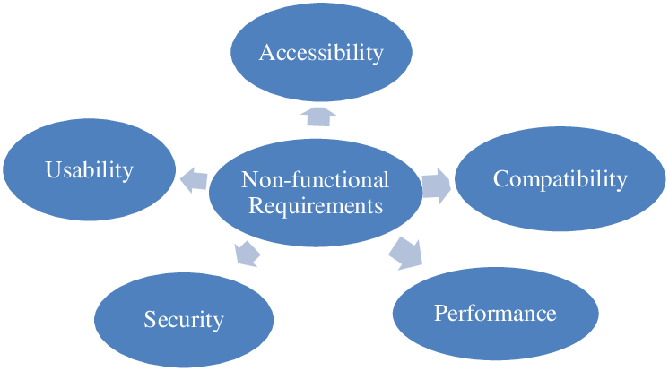
SRS for “ShopEasy:E-Commerce Website "
Non Functional Requirements
Usability
Security
Performance
Maintainability
Scalability
Reliability

Slide 6
SRS for “ShopEasy:E-Commerce Website "
Software Requirements
HTML
CSS
JavaScript
Hardware Requirements
External Hard Drive
Desktop/Laptop or Computer
Network Server
Mobile Device

Slide 7

Features
Responsive Website Design
User-Friendly Navigation
Multiple Security Features
Offers Mulitple Payment Options
Contact Page with Multiple Contact Options
Enticing product descriptions

Slide 8
Step-Wise Description
Created an SRS for this E-Commerce Website.
And then created a Github Account.
Then created an Github Repository.
Added the SRS Document in Github Repository.
Verify the upload in Repository.
Summary of your task
Just created an SRS for E-Commerce Website(ShopEasy) and uploaded in Github Repository.

Slide 9
Submission Github
https://github.com/Vignesh9345/vignesh
Your github should contain this ppt, readme file.

